Slide 1
What is Data Visualization? and Why Visualize Data?

Slide 2

Visualization Analysis and Design by Tamara Munzner Material Curran Kelleher

Slide 3
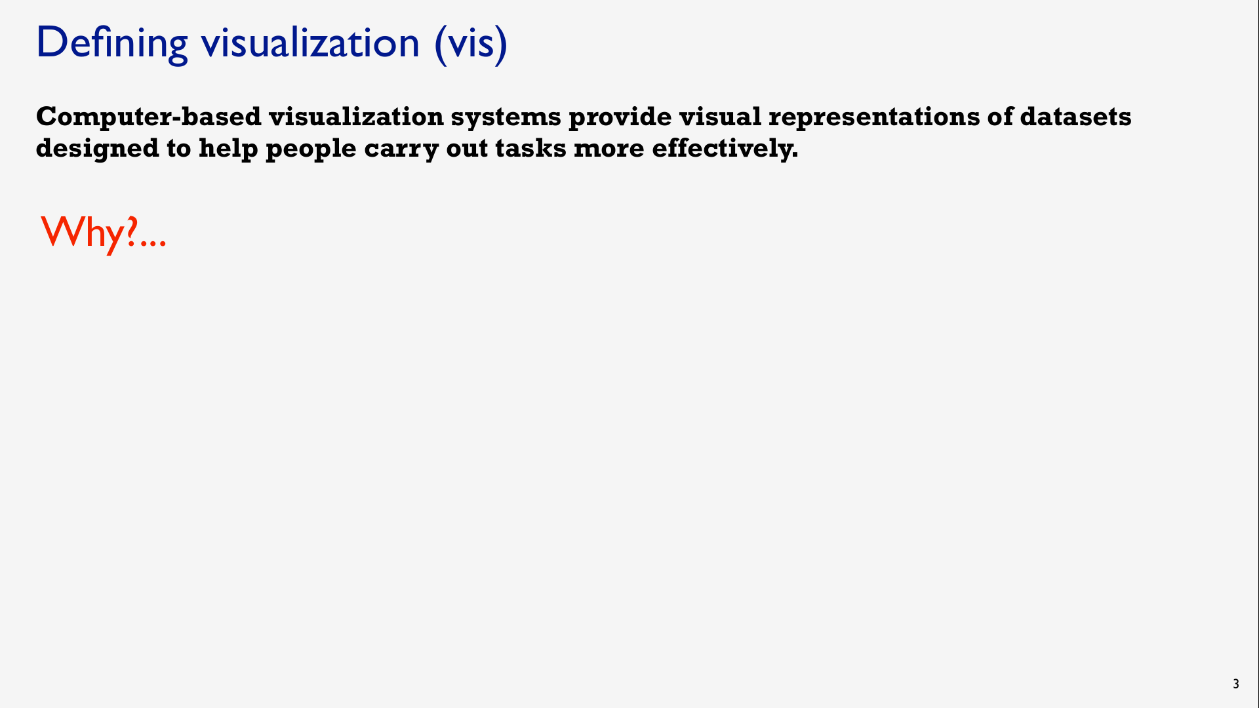

Slide 4
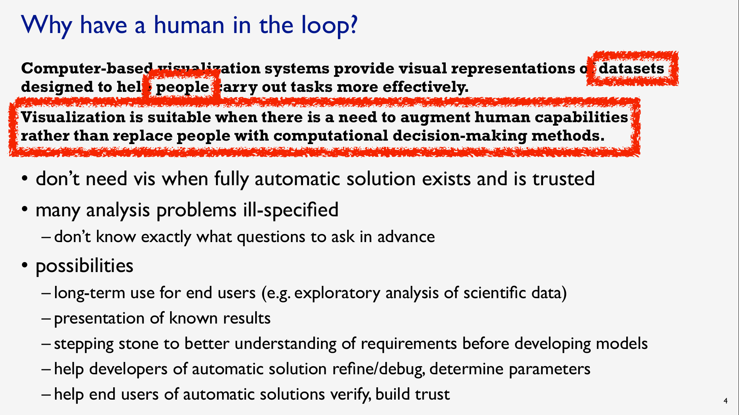

Slide 5
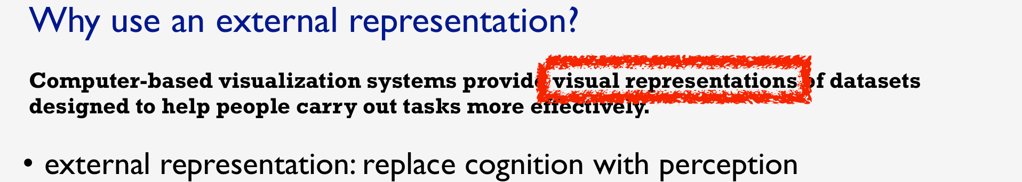

Slide 6
Example: Religions by Country
Which country has the most Hindus? The Data
The Visualization
https://gist.github.com/curran/0d2cc6698cad72a48027b8de0ebb417d#file-religionbycountrytop20-csv

Slide 7
Example: Religions by Country
Which country has the most Hindus? The Data
The Visualization
https://vizhub.com/curran/ef717a89e37a4d9285cebfa904790665

Slide 8
Example: Migrant Deaths
When and where did migrant deaths occur?
Are there any patterns or trends? The Data
The Visualization

Slide 9
Finding Visualizations
https://flowingdata.com/
https://fivethirtyeight.com/tag/data-visualization/
https://pudding.cool/
https://www.economist.com/graphic-detail
https://observablehq.com/explore

Slide 10
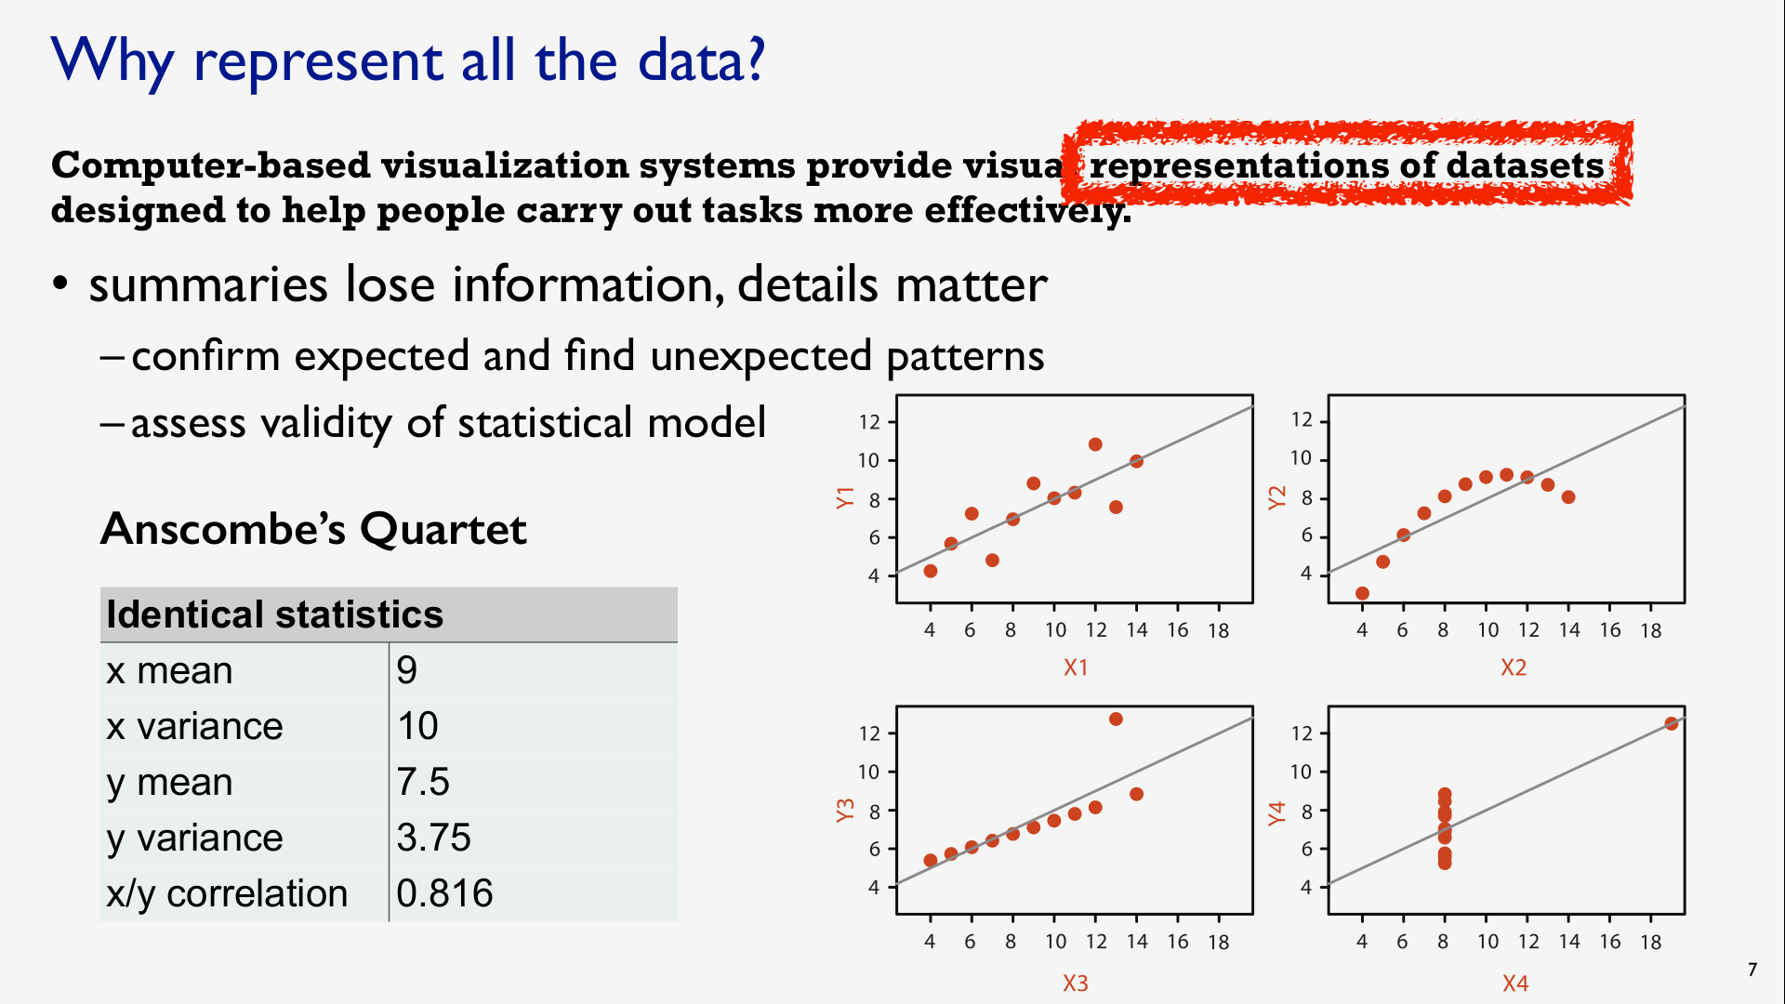

Slide 11
Input for Visualization
Data and Tasks

Slide 12
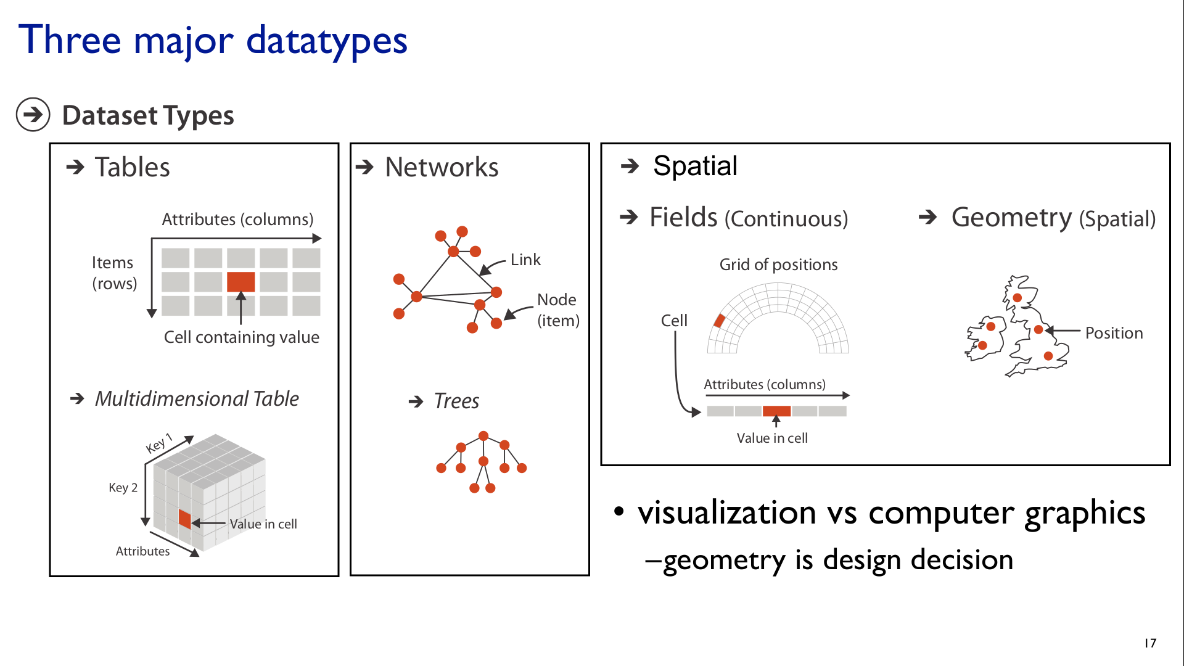

Slide 13
Attribute Types
Broad taxonomy for visualization design

Slide 14
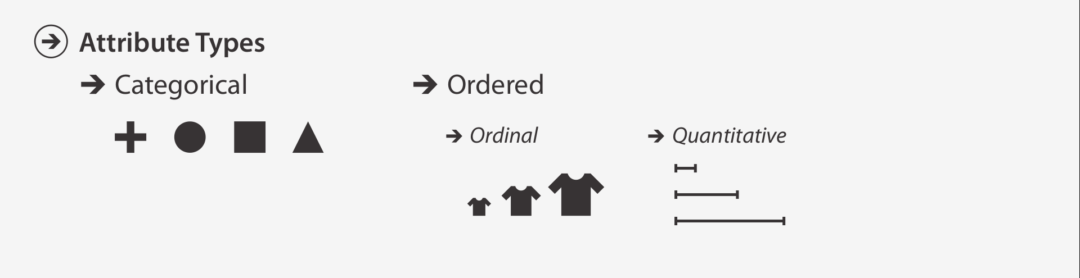

Slide 15
Special Cases
Time
Point in time
Region of time
Space
Point in space
Region of space

Slide 16
 | Point | Region
Space
Time
Quantity
(Latitude, Longitude)
e.g. “My current location”
Geographic Identifier e.g. Countries, States, Counties
Quantitative
Categorical
Instant
e.g. “Right now”
Interval
e.g. “This year”
Quantitative
Ordinal
Value e.g. 5.2
Interval
e.g. “5 - 10 years old”
Quantitative
Ordinal

Slide 17
Introduction to Web Technologies
Why use this platform?

Slide 18
We’ll discuss
Why use Web Technologies?
What are Web Technologies (HTML, JS, CSS, SVG)?
What is a JavaScript Library?
Why use D3 to make data visualizations?

Slide 19
Why use Web Technologies?
Accessible by anyone with a Web browser
Easy to use; No need to install anything locally
Advanced technology
Affords customizable, bespoke work
Unlimited potential for adding interactivity
Main reason

Slide 20








Web Technologies
Libraries
Frameworks

Slide 21
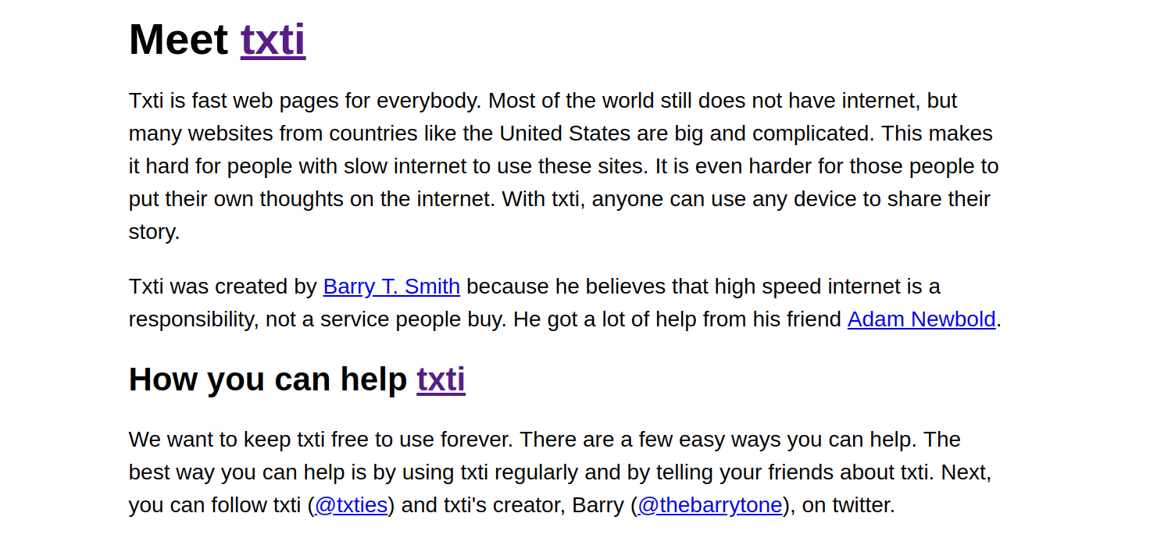

Slide 22
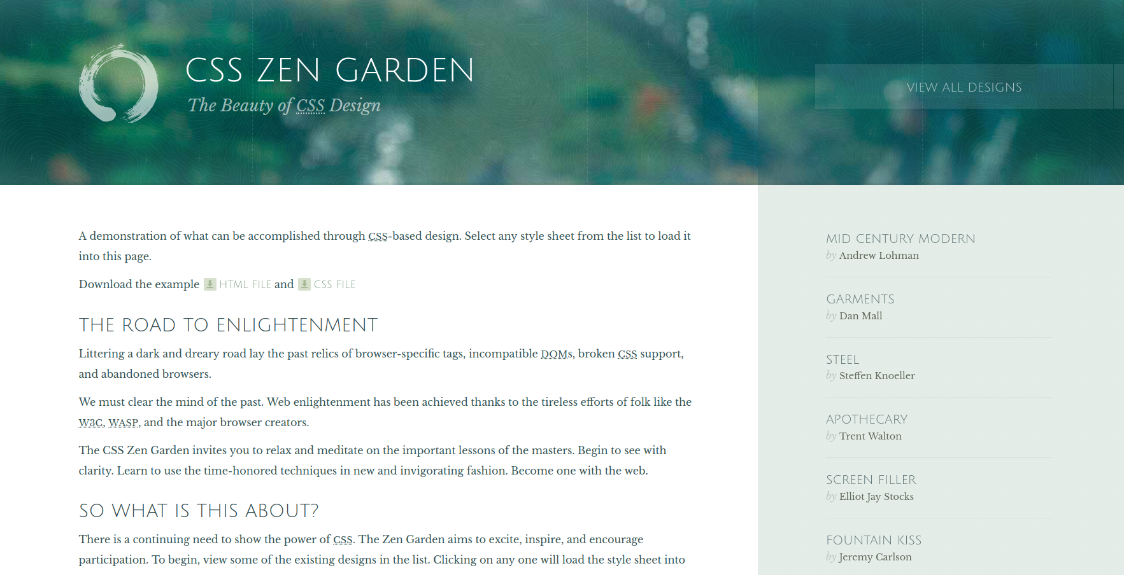

Slide 23
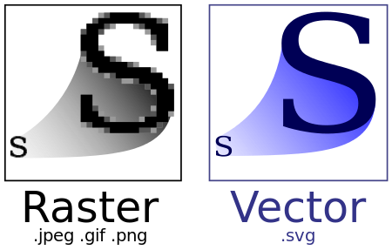

Slide 24
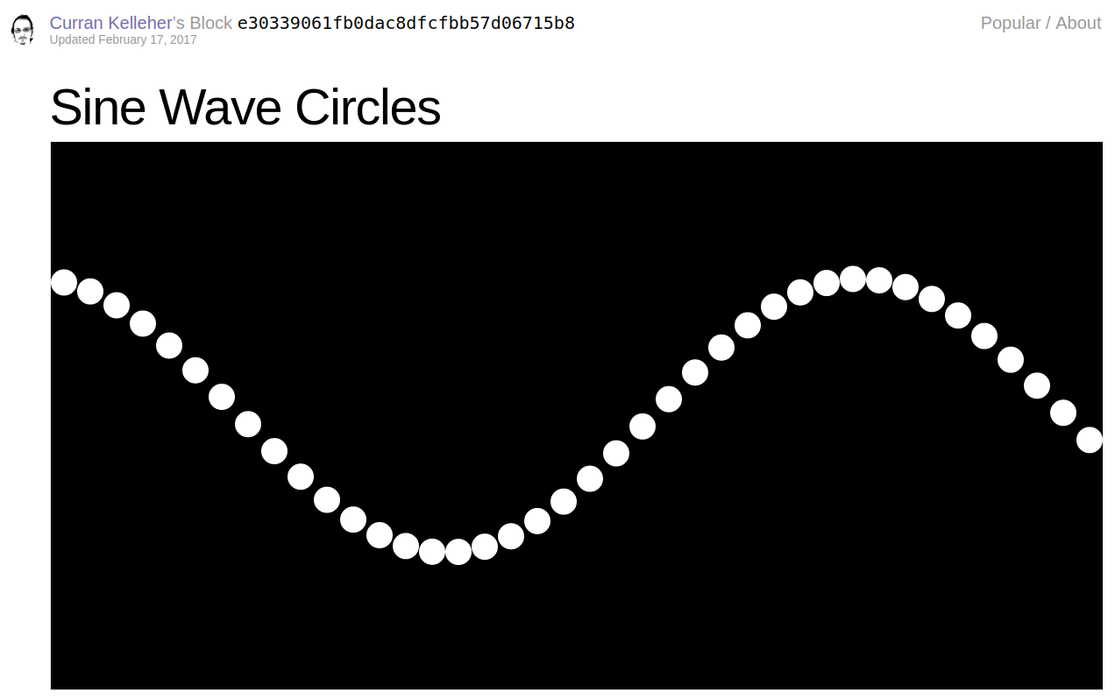
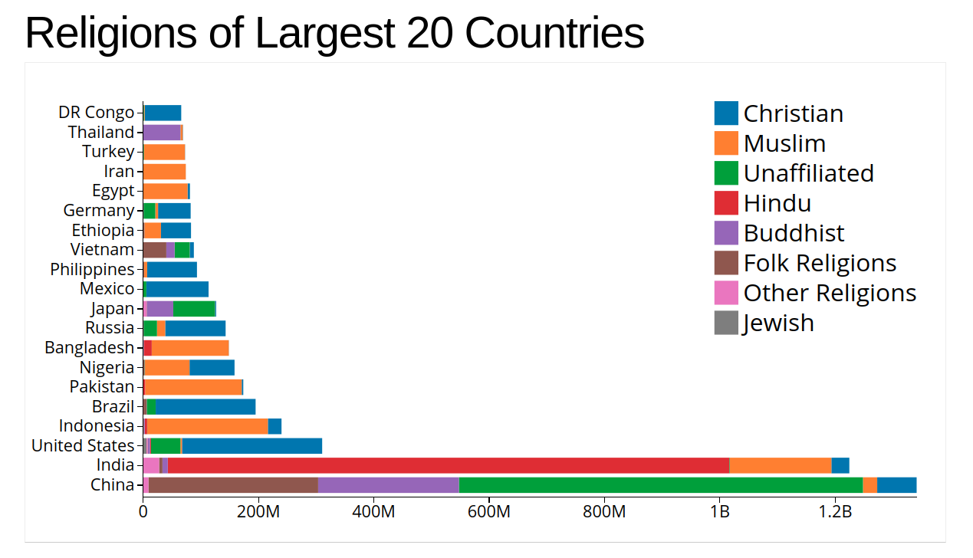
JavaScript Examples
vizhub.com/curran

Slide 25
Introduction to Tableau
Why use this platform?

Slide 26
Tableau
Tableau is the most robust, secure, and flexible end-to-end analytics platform for your data, and it is the fastest-growing data visualization tool used in the Business Intelligence Industry
Data analysis process is very fast with Tableau, and the visualizations created are in the form of dashboards and worksheets.

Slide 27
https://public.tableau.com/en-us/s/download

